Slide 1
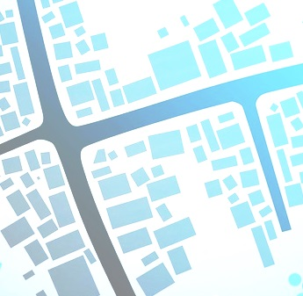
2nd International Conference on Urbanism and Spatial Mobility: Dynamics of Space; Mobility & Relationality

